Slide 1
VR gym TRainer
Robert Gavranović, Ivan Krstev, Amar Uvstadić

Slide 2
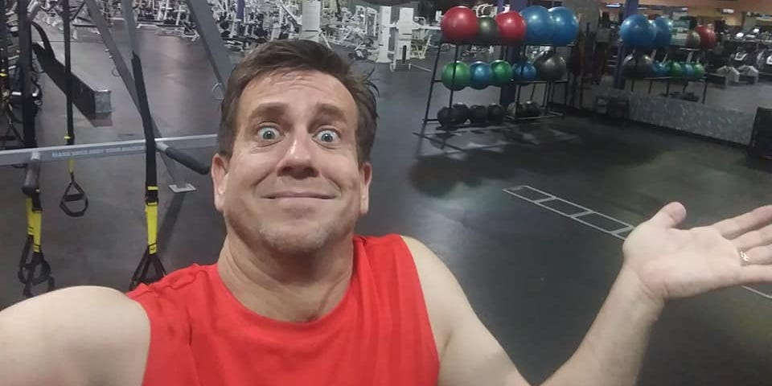
The Problem
We have noticed that so many people are having difficulties performing the exercises in the gym.
The reason why, is probably because they are not familiar neither with exercises or equipment that is used.
So, how we understood the problem?

Slide 3
SOLUTION
MAKE LEARNING PROCESS FUN
TARGET AUDIENCE
You are isolated in a virtual world,
which is customizable to your liking.
Everyone that does not like standard coaching in the gym and everyone with lower self-esteem and confidence
COST SAVINGS
EASY TO USE
It will save your time and money
It is basically Plug & Play.

Slide 4
PRODUCT OVERVIEW (PROTOTYPE)
UNIQUE
FIRST TO MARKET
First beautifully designed product that's both stylish and functional
AUTHENTIC
Designed with the help of Google and big brains

Slide 5
PRODUCT Description
USECASE
Learn compound movements with lowered risk of injury
MOTIVATION
Exercise in beautiful virtual environments, finding inspiration and peace
IN PROGRESS OF DEVELOPMENT
Still in modeling and testing phase
INTERGATION OF REACT AND UNITY
We use the WEB GL plugin for rendering high-performance 3D graphics from Unity

Slide 6
Technology used
Unity
XR interaction toolkit
C#
steamvr
React
Netlify

Slide 7

SUMMARY
We tried hard to make it boring,
but failed.

Slide 8
THANK YOU
Ivan Krstev
Robert Gavranović
Amar Ustavdić

